Slide 1
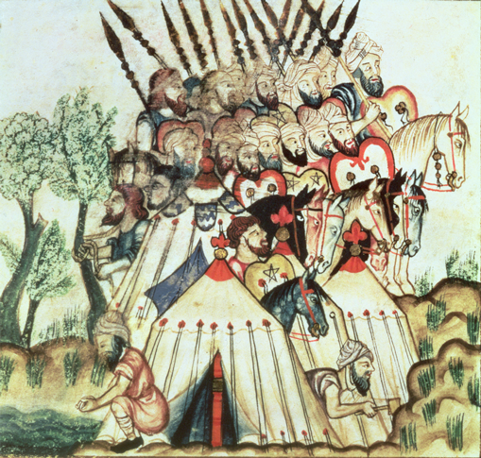
The Muslim World and Africa (730 B.C.-A.D. 1500)
Lesson 2 A Muslim Empire

Slide 2
The Muslim World and Africa (730 B.C.-A.D. 1500)
Lesson 2 A Muslim Empire
Learning Objectives
Describe the spread of Islam.
Identify the divisions that emerged within Islam.
Describe the rise of Umayyad and Abbasid dynasties.
Explain why the Abbasid empire declined.

Slide 3
Islam Faces Challenges
Arabs Join Together Under Islam
After Muhammed’s death the Muslims agree that Abu Bakr should lead them. He is named Caliph
Some Arab tribes refuse to follow Abu so he has to go and fight them to come back.
After doing so he is going to reunite all of the Arab tribes under Islam
Arab Muslims Win Victories
The first 4 Caliphs are going to fight Byzantium and Persia
They are going to take large parts of the Byzantine Empire and take out Persia completely. They will take Jerusalem

Slide 4
Islam Faces Challenges
This illustration from the 1100s shows Muslim soldiers setting up their tents by a river. Arab Muslim armies had a remarkable series of military victories under Abu Bakr and his successors.

Slide 5
Divisions Split Islam
Differing Ideas About Leaders
Some Muslims believed that Muhammed’s son in law, Ali, should lead them. They were called Shi’at Ali, or the Shiite’s
The Shiites believe that the descendants of Ali and Fatima, called Imams, are empowered to interpret the Quran and Muhammed’s actions
The majority of the Muslims believed that a successor should come from Muhammed’s tribe. He should be a political leader called a caliph
These people are going to be called Sunnis as they follow the example of the community or sunna.

Slide 6
Divisions Split Islam
Sunni and Shiite Beliefs
Both groups believe in the same God, look at the Quran for guidance, and follows the Pillars of Islam
They differ on religious practice, law, and daily life.
Today 90% of Muslims are Sunni
The Shiites have split into sub groups
When one group has been in power, it has abused the other group leading to tension in present day
Sufis Emerge
Sufis are Islam Mystics who seek communion with God via fasting, meditation, and other rituals.
They come from both branches of Muslims
They spread Islam by traveling, preaching, and being good examples

Slide 7
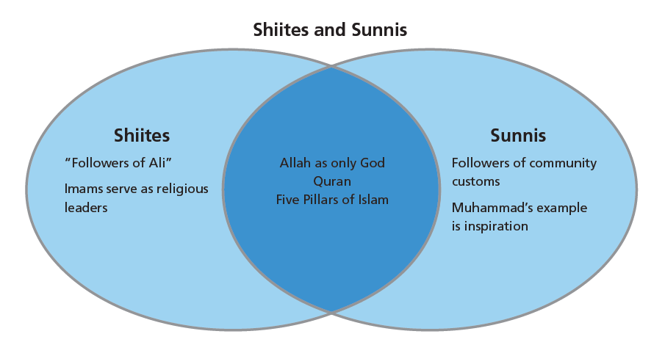
Divisions Split Islam
Analyze Charts This diagram shows the common beliefs held by Sunnis and Shiites, as well as their differences. What is a belief they share?

Slide 8
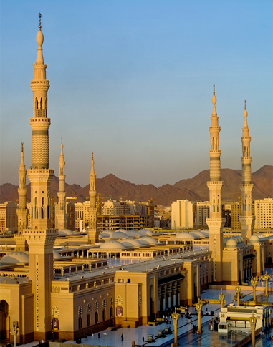
Divisions Split Islam
Medina is the second holiest site in Islam. Like Mecca, it is an important part of the hijra and Muhammad’s journey. Both sites attract many pilgrims.

Slide 9
Umayyad Caliphs Create an Arab Empire
The Muslim Empire Expands
After taking Egypt, Muslims move across North Africa, taking it from the Byzantines.
In 711 they cross into Spain and conquer it
In 732 they fight in the Battle of Tours but lose there and stop
Why the Muslim Empire Succeeded
The Persians and Byz. were exhausted from fighting each other
Use of camel and horse cavalry defeated traditional armies
Faith in Islam united all these tribes into a unified country
Conquered People Under Islamic Rule
They allowed Christians, Jews, and others to practice their faith but taxed them and gave them certain restrictions
They prohibited of looting conquered lands but they also made Arabs not mingle with others creating an upper class

Slide 10
Umayyad Caliphs Create an Arab Empire
Impact on North Africa
The presence of the Islam led to many changes
Carthage is destroyed and Kairouan is built
Many mosques are built in North Africa
The Development of Slavery
The growth of the empire started the slave trade.
At first captives were pressed into the army
Later on slaves will be purchased in West Africa and sold in North Africa
The Umayyad Caliphate Declines
Arabs had to learn how to rule vast areas instead of tribes
Non Arabs who converted to Islam had less rights than Arabs
While the caliphs grew more decadent more people complained
Shiites did not believe the Umayyad should be ruling

Slide 11
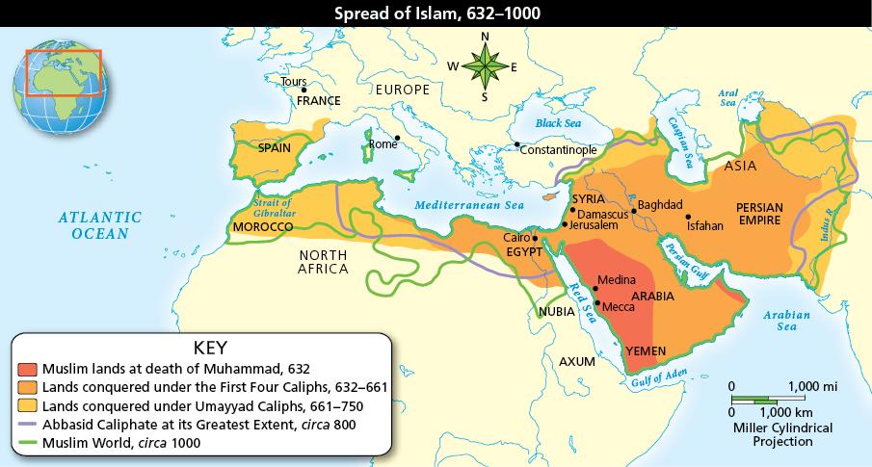
Umayyad Caliphs Create an Arab Empire
Analyze Maps Islam spread across northern Africa and into the Mediterranean. Near what important city was the further spread of Islam into Europe stopped?

Slide 12
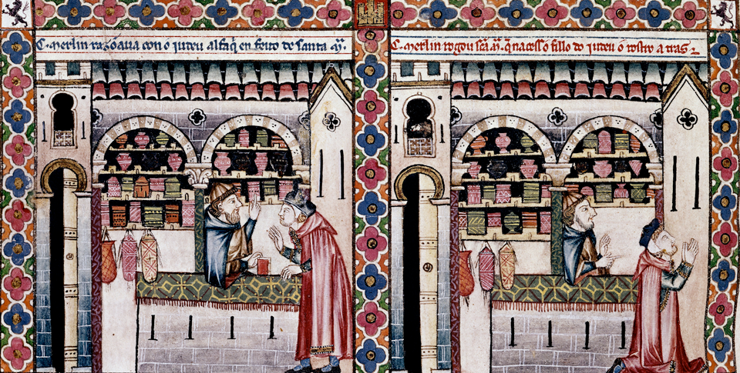
Umayyad Caliphs Create an Arab Empire
A Jewish apothecary, or pharmacist, dispenses medicine in a Spanish market. What does this tell you about life in Muslim regions?

Slide 13
New Rule Under the Abbasid Dynasty
The Abbasids Make Changes
They are going to halt large military conquests
They are going to encourage conversion to Islam and treat all Muslims fairly
They are going to move the capital from Damascus to Baghdad, inside of Persian territory.
The Amazing City of Baghdad
Built by the 2nd Caliph al-Mansur
City of Peace, Gift of God, Paradise on Earth
Exceeded Constantinople on size and wealth
Markets sold goods from Africa, Asia, and Europe

Slide 14
New Rule Under the Abbasid Dynasty
A Muslim State in Spain
The surviving member of the Umayyad family established an independent Muslim country in Spain
Tolerant of other religions, such as in Cordoba where they had Jewish officials and asked Christians scholars to study there
Muslims ruled parts of Spain until 1492
Causes and Effects of the Development of Islamic Caliphates
One cause was the emergence of Islam which helped unify the Arab tribes
Another cause was the weakness of the Persian and Byz. Empires
One effect was the spreading of Arabic and Islam along North Africa and Asia. In those locations today those are the leading language and religion

Slide 15
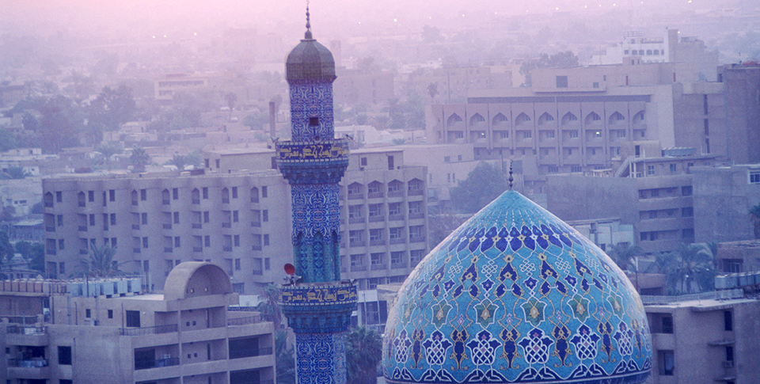
New Rule Under the Abbasid Dynasty
The Abbasid dynasty had a lasting impact on the Muslim world with its significant cultural and political accomplishments. In addition, the Abbasid capital of Baghdad remains an important city and is the capital of modern-day Iraq.

Slide 16
Decline of the Arab Empire
Seljuk Turks Gain Control
They come from Central Asia, adopt Islam, and form an empire across the Fertile Cresent.
By 1055 a Seljuk sultan controls Baghdad but keeps the Caliph as a figurehead.
They fight the Byz prompting the start of the 1st Crusade
Mongols Advance Through Central Asia
1216 Genghis Khan is going to lead armies out of Asia to conquer
In 1258 Hulagu, his grandson, is going to loot and burn Baghdad
Mongols are going to adopt Islam
When the caliph dies in 1258 Islam influence will weaken until Mongol rulers convert to Islam

Slide 17
Decline of the Arab Empire
A Divided Muslim World
By the late 1200’s the Arab empire is fragmented
Independent Muslim states and caliphates are scattered around North Africa and Spain
Just as politically divided as the Christian world
Islam will continue to link diverse people around a large area
Other Muslim empires will emerge to rule the Middle East and India

Slide 18
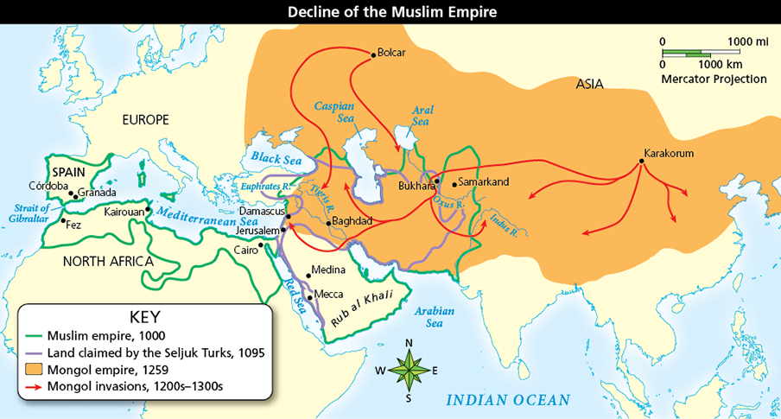
Decline of the Arab Empire
Analyze Maps Repeated invasions from the Mongols, first led by Genghis Khan, weakened the Abbasid caliphates. Where did the invaders come from?

Slide 19
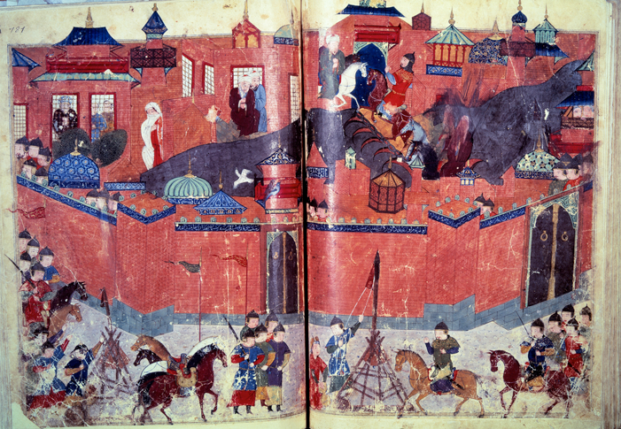
Decline of the Arab Empire
This illustration from a Persian manuscript shows the siege of Baghdad by the Mongol armies of Hulagu in 1258.

Slide 20
Quiz: Islam Faces Challenges
The Byzantines and Persians had not expected to lose land or battles to Arab Muslims because
A. the newly united Arab Muslims had not posed a threat before.
B. many different groups of Arab Muslims attacked at once.
C. the Arab Muslims had already lost many battles.
D. Sharia prohibited the use of military force.

Slide 21
Quiz: Divisions Split Islam
Which of the following is a belief held only by the Sunni?
A. Any good Muslim could lead.
B. Any pious male from Muhammad’s tribe could lead.
C. Only descendants of Ali and Fatima could lead.
D. Only Sufis could serve as leaders.

Slide 22
Quiz: Umayyad Caliphs Create an Arab Empire
The Ummayad caliphates successfully conquered and then ruled a vast empire by
A. aligning with European and African forces.
B. attacking weakened empires and using advanced weaponry.
C. promising fewer laws and no taxes for non-Muslims.
D. getting the Byzantines and Persians to submit peacefully.

Slide 23
Quiz: New Rule Under the Abbasid Dynasty
The Abbasids made changes to the Arab Muslim empire to
A. create an empire based on equality for Islam, Christianity, and Judaism.
B. concentrate on further conquests and enlarge the empire to include much of western Europe.
C. appeal to all classes of Muslims, people of different religions, and conquered Persians.
D. give more authority to wealthy Muslims and create distinct social classes.

Slide 24
Quiz: Decline of the Arab Empire
What events caused the decline of the Abbasid dynasty?
A. The Umayyads and the Abbasids waged a civil war that destroyed the empire.
B. The invaders from Spain created small kingdoms throughout the former empire.
C. The Abbasid empire fragmented, and other peoples gained control.
D. The Abbasids willingly gave up their lands to the Seljuk Turks and the Mongols.

